Slide 1

Quantum Computing in Israel – 2025
A Strategic Snapshot
By Candace Gillhoolley, Co-Host, ImpactQuantum.com

Slide 2

Why It Matters
Israel isn’t catching up—it’s creating its own rules.
Legacy of cybersecurity innovation
High STEM density, military-academic-startup ecosystem
Strategic global footprint
“Smart. Focused. Unapologetically Israeli.”

Slide 3
Core Highlights
No National Strategy Yet – ₪1.2B invested via Israeli Innovation Authority
Academic–Startup–Defense Convergence – 4 top universities + startups + IDF
Global Alliances – U.S., Europe, India, UAE
Milestone – 5-qubit processor (QuantLR + Technion)

Slide 4


Opportunities & Challenges
Opportunities:
• Post-quantum encryption leadership
• Fast civil–defense tech transfer
• Dense, world-class STEM talent
Challenges:
• Fragmented funding & strategy
• Hardware scalability
• Global competition ramping up

Slide 5
2025 & Beyond Forecast
Focus Area | Strategic Forecast
Hardware | Analog innovation from LightSolver & Bar-Ilan
Algorithms | UX-first tools by Classiq, QEDMA
Roadmap | Formal national strategy in 2026
Regional Collabs | UAE–India–Israel triangle in defense, agri-tech, desal
Quantum Security | Post-quantum pilots via Israeli cyber firms (Q4 2025)

Slide 6

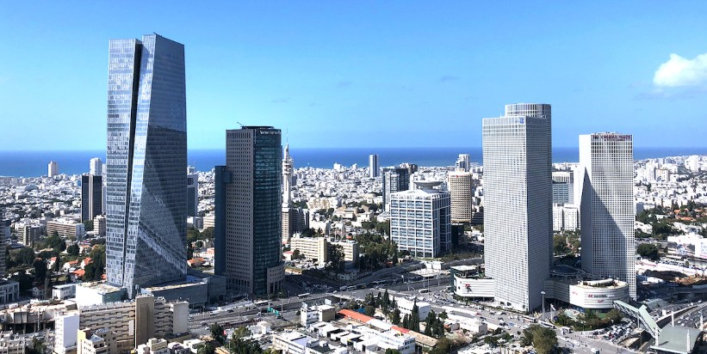
National Strategy & Sovereign Priorities
No national quantum playbook, but real momentum
₪1.2B+ invested; Quantum Israel Initiative leads
5-qubit processor → secure comms testing network

Slide 7
The Triangle That Works
Academia: Weizmann, Hebrew U, Technion, Bar-Ilan
Startups: Classiq, Quantum Machines, LightSolver, QEDMA
Defense: IDF Talpiot, Rafael, Elbit
- Integration is Israel’s competitive edge

Slide 8
Global Ties, Quiet Power Moves
U.S. – Cloud R&D (IBM, Google), QIS link
Europe – ETH Zurich, CEA collabs
India – Bi-national centers (Bangalore, Be’er Sheva)
UAE – Quantum Security Lab (Abraham Accords)

Slide 9


What’s Working vs. What’s Wobbly
Working:
• Cyber synergy
• Defense–civil tech transfer
• Talent density
Wobbly:
• Missing national strategy
• Hardware gaps
• Global competition pace

Slide 10


Final Thought – Strategic Scale Ahead
Agility got Israel here. Strategic scale must take it further.
From experimentation → infrastructure, economic force

Slide 11

Call to Action
🎧 ImpactQuantum.com Podcast
#QuantumIsrael #CyberQuantum #StartupNation
Download full report at ImpactQuantum.com

